Slide 1

Making this resource work for you
Prior to teaching this lesson, please refer to the ‘Unit Overview and Planning Document’.
Further guidance on planning Science Mastery lessons can be found in the detailed planning guidance document.
Refer to the ‘notes’ section on each slide for useful information, including suggested expositions, pedagogical content knowledge, suggested questions, answers and more. Consider using presenter mode so you can see this guidance throughout the lesson.
The introduction slides can be adapted to suit your teaching style and the needs of your class.
Before the lesson, adapt the fix-it slide to address any misconceptions identified in the previous lesson’s exit ticket.
Choose from the suggested activities to suit your class. The intention is not that you complete all of these, but that you select those which ones are most appropriate for your students. It may be appropriate to further adapt activities for your students.
These lessons are designed to occupy approximately 1 hour. To adapt for a shorter or longer lesson duration we advise you to adapt the activity section accordingly.
Please consider using the final slide to send feedback about this lesson or examples of PowerPoints that you have adapted to our design team. Your feedback is used to improve Science Mastery for all of our teachers and students. We appreciate all suggestions and comments.
Thank you for reading!
The Science Mastery Team

Slide 2
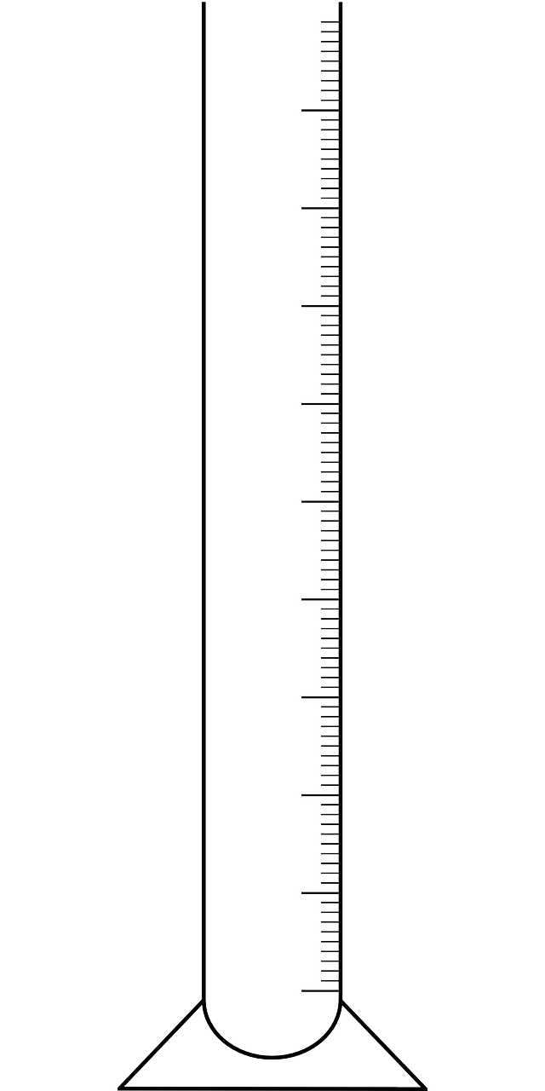
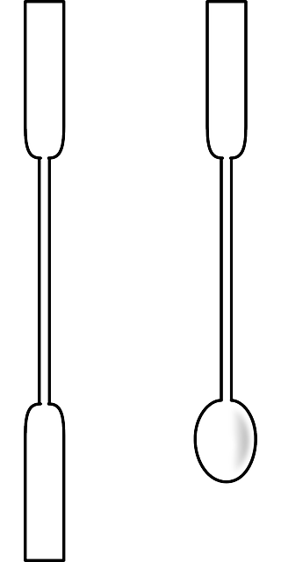
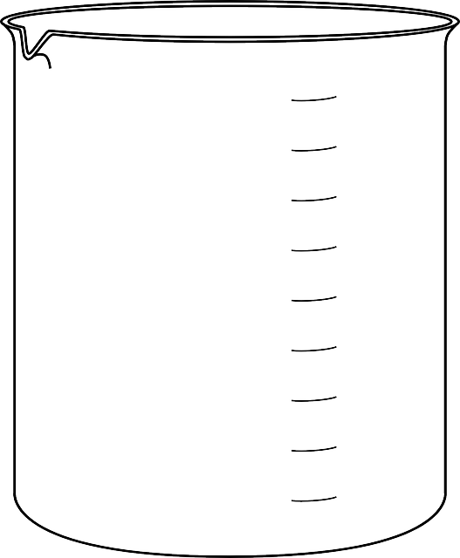
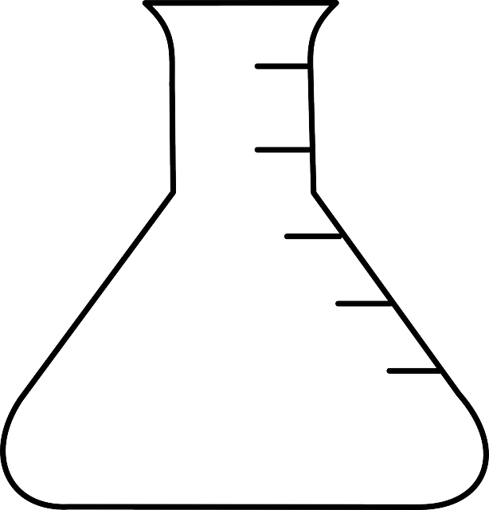

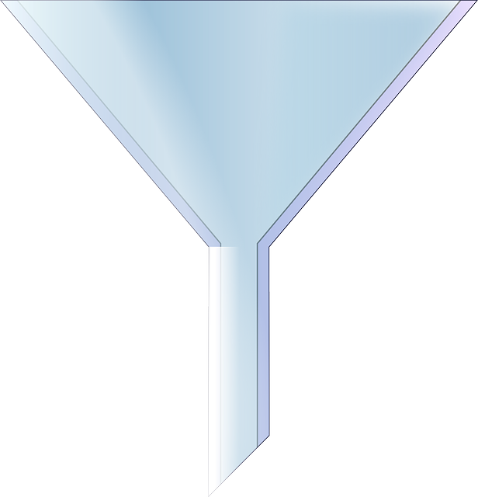
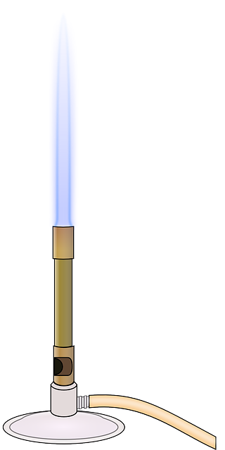
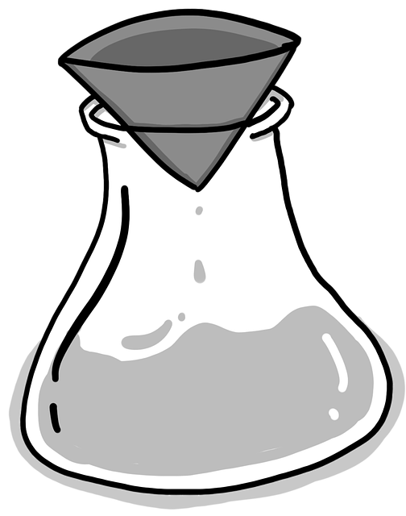
Making Soluble Salts 2
Name the equipment shown below.
Beaker
3.
4.
1.
Glass rod
Spatula
2.
8.
6.
Graduated cylinder
5.
7.
Evaporating dish
9.
Conical Flask
Funnel
Filter paper
Bunsen burner
Notes:
Purpose: to assess learning from before the lesson and interleave prior knowledge.
Foundation: Which of the items of equipment could possibly be used to measure volume of a liquid?
Stretch: Which of those do you think would give the most precise measurement?
Answers:
Foundation: 2, 4, 6
Stretch: The graduated cylinder
Note: Bunsen burner always has a capital ‘B’ as it was named after a person, Robert Bunsen.

Slide 3
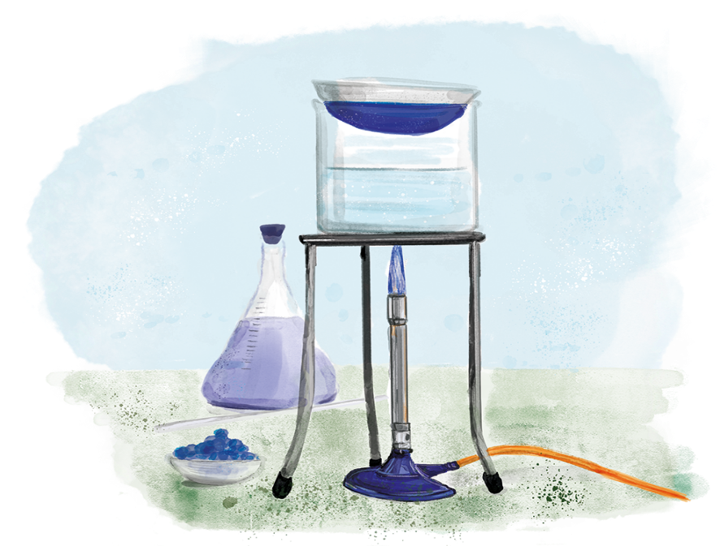

C3.2.11
11/02/2025
Making Soluble Salts 2
C3.2.1 Prior Knowledge Review
C3.2.2 Relative Formula Mass
C3.2.3 Percentage by Mass
C3.2.4 Conservation of Mass
C3.2.5 Balancing Equations
C3.2.6 Uncertainty
C3.2.7 Introducing Concentration
C3.2.8 Concentration Calculations
C3.2.9 Soluble Salts
C3.2.10 Making Soluble Salts
C3.2.11 Making Soluble Salts 2
Notes:
This lesson links to the big idea Reactions Rearrange Matter. In the previous lesson, students have learned the theory behind making soluble salts. In this lesson, students will learn about the steps in the method for making soluble salts, bringing together skills learned previously, such as writing a risk assessment and filtration.
Suggested hook:
Set up a simple demo of filtration (perhaps use sand and salt-water) or show students a diagram, to remind them of the setup and purpose of filtration. Ask students to explain why sand stays in the filter paper but the salt particles can pass through into the filtrate/conical flask. Salt particles are in solution and are small enough to fit through the tiny holes in the filter paper.

Slide 4

Following this lesson, students will be able to:
Justify the techniques used for the practical activity to prepare a pure, dry sample of a soluble salt
Explain how to measure volumes of liquid accurately
Evaluate the quality of crystals produced
Key Words:
meniscus
accurate
justify
concentration
volume
crystals

Slide 5
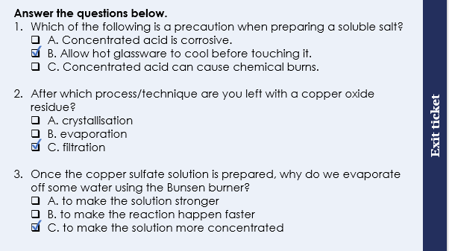
This is the fix-it portion of the lesson
The fix-it is an opportunity to respond to gaps in knowledge, especially those identified by the previous lesson’s exit ticket.
The teacher should customise this slide as needed, to facilitate
reteach, explanation, demonstration or modelling of ideas and concepts that students have not yet grasped or have misunderstood.
practise answering specific questions or of key skills.
redrafting or improving previous work.
Notes:
Purpose: to spend time on any gaps identified in previous learning from exit ticket feedback.
Fix-it guidance from previous exit ticket:
Q1. Answer: B
If students answer A or C this suggests a confusion between hazards and risks. To fix-it, recap the definitions of hazards and precautions and then ask students to sort the following into hazard and the linked precaution: broken glassware can cut, Bunsen flame can burn hair or skin, hot glassware can burn skin, irritants can irritate skin, be careful handling glass and keep it centre of the table, tie back hair and stand up and away from Bunsen flame, let glassware cool down before touching, ensure containers are kept away from the edge of the bench and be ready to wash skin under running water if in contact with irritants.
Q2. Answer: C
If students answer A, this suggests a misconception that crystallisation ends up making a residue. To fix-it, reteach that crystallisation makes crystals. Then ask students to describe what happens during crystallisation and during filtration.
If students answer B, this suggests a misconception that evaporation ends up making a residue. To fix-it, reteach that evaporation means water has left the solution, leaving behind the solute/soluble salt. Then ask students to describe what happens during evaporation and during filtration.
Q3. Answer: C
If students answer A, that students have confused the terms ‘strong’ and ‘concentrated’. This distinction was made initially when students studied acids and alkalis in C2.1 and should be revised here. To fix-it, show students examples of strong and weak acids with reference to the pH scale. Then contrast this with a concentrated and dilute solution, using particle diagrams to illustrate what these terms mean.
If students answer B, this suggests a confusion of this step with the one where the Bunsen heats the acid in order to speed up the (rate of) reaction.
To fix-it, ask the students order the steps of the method when you present it to them in a random order. Then ask students to explain why each step is important.

Slide 6
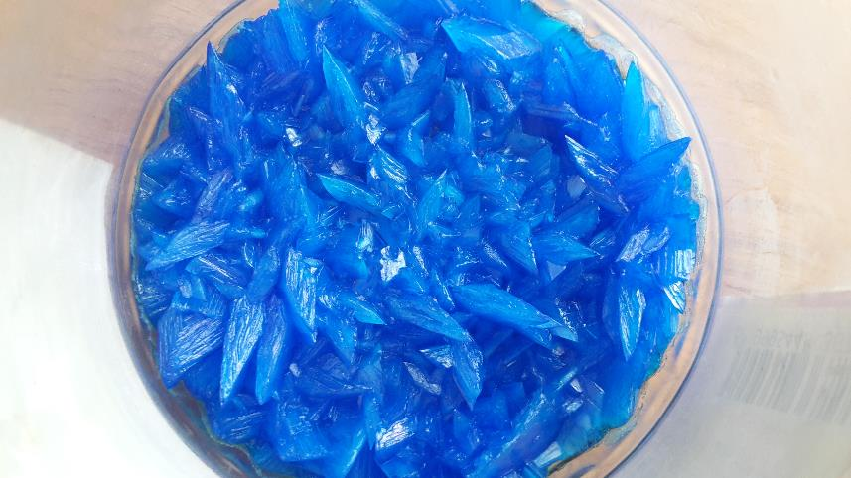
Let’s examine our copper sulfate crystals carefully
Large crystals form slowly. Perhaps the water evaporated over a few days.
Small crystals form quickly. Perhaps the water was evaporated quickly using a Bunsen burner.
What does it mean if the crystals aren’t clear blue, or if there’s some grey or black colouring?
The black copper oxide powder wasn’t all removed by filtration. Filtration needs to be improved.
Notes:
Exposition type: Explanation
Suggested teacher exposition:
Students should be given the crystals they prepared from the practical last lesson, and a magnifying glass to examine them closely.
Do they look like the ones in this image?
Are they smaller or larger than this image? Crystal size is affected by the speed at which they were formed.
Are your crystals pure? Can you see anything else in the sample? Pure crystals will be made of only the soluble salt you made and nothing else. So, if you see another colour, then the presence of this substance means that the crystals are impure.
The size of the crystals formed will depend on the time taken to form them. Larger crystals were formed slowly, so this might happen if the water evaporated over a few days. Smaller crystals form quickly, so this might happen if all the water evaporated quickly when a Bunsen burner was used to heat. This point about the large crystals forming slowly and the small crystals forming quickly links back to your knowledge of the rock cycle, where igneous rocks cool slowly inside the volcano (intrusive rocks) forming large crystals and when they cool quickly on the Earth’s surface (extrusive rocks), this results in small crystals.
What does it mean if the crystals aren’t clear blue, or if there’s some grey or black colouring? The black copper oxide powder wasn’t all removed by filtration. Filtration needs to be improved. We will now explore how this could be improved if we were to repeat this practical by evaluating the method we used.
Image source
https://commons.wikimedia.org/wiki/File:Copper_Sulfate_Crystals.jpg

Slide 7
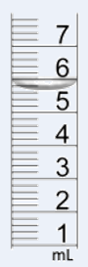
Measuring volume of liquids
What should we use to measure the volume of liquids if we do want to be very accurate?
5.6 mL
Notes:
Suggested teacher exposition:
When we evaluate a method we need to think about the reason we carried out each step and whether it allowed us to get valid results. In step 1 of our method, read step 1, it stated that we didn’t need to be accurate with measuring volume. But…
what should we use to measure the volume of liquids if we do want to be very accurate?
Graduated measuring cylinders are used to measure the volume of liquids accurately. Conical flasks and beakers show the approximate volume with large intervals. Model this with some equipment e.g. 200, 300, 400, 500 mL on a conical flask.
If we look up close at the graduations (the small lines in between the numbers of the scale) on a measuring cylinder we can see that these give us a specific volume. On this diagram there are 4 graduations between each ‘big’ line, so we can use this to read off the volume. A very important consideration when measuring volume is to look carefully, moving your eye to the top of the liquid, and observe where the bottom of the meniscus is – it is shown by the arrow here. Demo this with a large cylinder. This is where you use the graduations to read off the volume. The meniscus is this curved line that appears at the top of the liquid in the cylinder.
For this example the volume shown is 5.6 mL. We can see that the bottom of the meniscus touches the 3rd graduation line above 5. If we treat this like a ruler, we know that this reads as 5.6.
Suggested activity:
Give each group of students a conical flask, beaker and graduated cylinder. Ask them to examine them carefully and decide which one will allow you to measure a volume of liquid most precisely.
Now ask each group to measure out exactly 53 mL of water using each of the three. They should be able to see that the graduations on the graduated cylinder allow for a much more precise measurement.
Demonstrate the use of a pipette to measure even more accurately, however students do not need to be able to operate this themselves yet. Showing the scale pop up on the slide, explain how we read volumes of liquids from the bottom of the meniscus.
Images from pixabay

Slide 8
Evaluating our method
What could we have changed to improve this method?
How could we improve this method to ensure that all of the copper oxide was filtered out of the solution?
Sprinkle a small amount of water onto the filter paper before filtering so it sticks to the funnel.
Only pour a small amount of solution into the filter paper at a time.
Give it time to drip through the filter paper. Don’t swirl the funnel or poke with a glass rod!
Notes:
Suggested teacher exposition:
When we evaluate a method we need to think about the reason we carried out each step and whether it allowed us to get valid results. In step 7 of our method it says to ‘filter the contents of the beaker from step 3’. This might not include enough detail to ensure that filtration is done properly.
So how could we ensure that all of the copper oxide was filtered out of the solution?
Sprinkling a small amount of water on the filter paper means it sticks to the funnel and the solution won’t be able to flow down in between the filter paper and funnel, into the filtrate.
Only pour a small amount of solution in at a time so that the mixture flows evenly and doesn’t go down the sides of the filter paper
We don’t poke or stir the liquid in the funnel because this risks poking a hole in the wet filter paper. Now we will look at another version of the method and evaluate it by suggesting improvements.

Slide 9


Use thumbs up or down to show if each statement is true or false. Rewrite the false statements to make them true.
The volume of a liquid in a cylinder is measured from the highest point of the meniscus.
Which graduated cylinder is more accurate than a beaker when measuring the volume of a liquid.
Pure crystals should only be one colour.
Large crystals form fast whereas small crystals form slowly.
When making soluble salts, the acid is gently heated to evaporate the water before crystallisation
It is read from the BOTTOM of the meniscus
Large crystals form SLOW whereas small crystals form FAST.
Acid is heated so that the neutralisation reaction happens faster
Notes:
Purpose: to check that key knowledge from the introduce phase has been learnt and understood.

Slide 10

Read this basic method to prepare a soluble salt.
The solid is added to the acid until no more reacts.
Excess solid is filtered off to produce a solution of the salt.
The solution is heated a bit.
This concentrated salt solution is crystallised to produce solid salts.
The salt is patted dry between two pieces of filter paper.
Suggest 3 improvements that could be made to this method.
Explain why they would improve the method
Notes:
Possible answers
Include which solid and which acid is being used – because then we know what specific salt is being produced and which substances to use
Include names of specific pieces of equipment – because then we have more information about how to carry out the practical safely and correctly
Include specific volumes or masses of substances – because then we can use the correct amount rather than guess
In step 3, ‘a bit’, is vague and not scientific. It could be improved by saying, heat gently for 2 minutes using a Bunsen burner – because then we know exactly how much to heat the solution
In step 4, ‘is crystallised’, is vague and should include specific instructions about how to carry this out – then crystallization will be done is a consistent way
Suggested guidance:
Talk tasks can be used in a variety of ways to suit the particular needs of the students you are teaching. Through exchanging views with others, students develop their understanding of the science beyond what could be achieved individually.
Science classrooms that successfully integrate talk have the following features:
Science talk is a regular feature of lessons and is woven into classroom activities.
Students are paired or grouped strategically by the teacher to ensure productive interaction. This might take into consideration the students’ proficiency of the English language, how encouraging they might be to peers and their attainment in the topic. It’s a good idea to consider these pairings in the class seating plan.
Students are encouraged and supported to talk, but are not forced to talk.
The teacher should take on the role of a facilitator, engaging with conversations where necessary and encouraging or steering the conversation where needed.
Students are encouraged to use the language they have to express their ideas (e.g., everyday language, imperfect English, native language), but also to incorporate science specific terminology where this is more accurate or has been taught.
6. Scientifically inaccurate ideas are not dismissed by the partner or teacher; open discussion and further investigation are relied on to help students construct ideas that support them to progress in their scientific understanding.
7. Guidelines for behaviour during talk tasks are explicit and frequently reviewed. Rules for students might be:
Listen carefully to your partner
Take turns talking.
Speak one at a time, without interrupting.
Politely agree or disagree and explain why.
Politely point out if your partner has used a scientific word incorrectly, if they have explained the science incorrectly, or if there is a more accurate way to describe something.
If confused, ask questions.
Stay focused on the discussion topic.
Respond to one another.

Slide 11
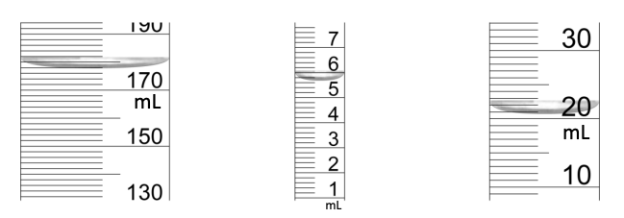
Drill
What is a meniscus?
How do you measure the volume of a liquid accurately?
What is the volume of this liquid?
Why is the acid heated gently?
Why is copper oxide added in excess? What pieces of equipment is used for filtration?
What pieces of equipment are used for crystallisation?
During the crystallisation process, large crystals formed. What does this tell you?
Some parts of the crystal appear black. Why might this be?
Notes:
Purpose: This is a knowledge drill. The purpose of this is to check that the critical knowledge is secure before pupils move onto independent practice.
Suggested guidance: There are a range of ways this could be done depending on time and ability range of the class:
Mini whiteboards
As full sentences in exercise books
As short answers in exercise books
In the pupil workbook
As pair talk
As cold call

Slide 12
Drill answers
The bottom part of a curve over liquid in a container To measure the volume of a liquid accurately use a graduated measuring cylinder
5.6 cm³
To speed up the reaction Copper oxide is added in excess to ensure that all the acid has reacted A conical flask, funnel and filter paper are used for filtration Evaporating dish, pipe clay triangle, Bunsen burner, tripod and heat proof mat are used for crystallisation
Large crystals are formed if the water evaporated slowly from the salt solution
Some copper oxide got into the filtrate. So, the crystals appear black
Notes:
Purpose: This is a knowledge drill. The purpose of this is to check that the critical knowledge is secure before pupils move onto independent practice.
Suggested guidance: There are a range of ways this could be done depending on time and ability range of the class:
Mini whiteboards
As full sentences in exercise books
As short answers in exercise books
In the pupil workbook
As pair talk
As cold call

Slide 13
I: Improving a method
The copper sulfate is added to hydrochloric acid until no more reacts.
Excess copper oxide is sieved out to produce a solution of the copper sulfate.
The solution is heated for until it becomes a white powder.
The salt is patted dry between two pieces of filter paper.
Spot the mistakes in this method and suggest how you will change to improve it.
1. The reaction is between copper oxide and sulfuric acid. Copper sulfate is being made. Make sure to use the correct names of reactants
2. Using the word ‘sieved’. This is not the scientifically correct key word. You must use filtered.
3. Heat the solution until it becomes a white powder. The solution has been heated for too long. We must heat gently until a small amount of water is left.
Notes:
Explanations
1. Students often get confused between the names of the reactants and products so it's very important to stress what is being used and what is being produced. 2 Sieved is a common word used in everyday language and although filter paper and sieving do the same thing, at this stage students should realise that there is a technical difference. 3 This part of the answer is nuanced. Students have to be able to judge when there is a small amount of water present so that the heat of the evaporating dish can evaporate the rest of the water without driving out the water that is ‘trapped’ within the crystals. The water molecules that are trapped are referred to as ligands at A level but to explain this to year nine students it is better at this stage to use this word trapped. Excessive heat can remove the trapped water which then leads to the blue crystals becoming a white powder.

Slide 14
We: Improving a method
The copper oxide is added to excess hydrochloric acid.
Unreacted copper oxide is filtered out.
The copper chloride solution is left on a windowsill to produce big crystals.
The salt is patted dry between two pieces of filter paper.
Spot the mistakes in this method and suggest how you will change to improve it.
1. Using excess hydrochloric acid means you can't easily tell if an acid has reacted. Copper oxide is used in excess to ensure that the acid has reacted completely not the acid.
2. There is no excess copper oxide as any that is added would have reacted. Always ensure that copper oxide reacts completely and then add another spatula full until no more copper oxide reacts.
3. Using a windowsill to evaporate the water does work but its not part of good scientific method. Use a water bath or heat gently with a Bunsen burner.
4. Why would you pat dry crystals that are already dry? Do not include this step in this method.
Notes:
Explanations
1. You cannot ensure a colourless liquid like hydrochloric acid has completely reacted unless you are using other tests like pH paper. It is therefore better to use a visible solid like copper oxide or any other oxide and add it until no more reacts with the acid. At this point you know that's all of the acid has reacted. This would then mean that there will be no acid present within your salt crystals. 2. If you are using excess acid in this reaction then you will never have an excess of the metal oxide. It is therefore important to heat the acid enough so that it can react with the metal oxide. You then add small amounts of metal oxide until it no longer reacts. 3.. Due to limitations with time teachers will often leave the evaporating dish at the side of their rooms to evaporate naturally. Although this is technically correct, within the scientific methodology we should not be using such methods, it is important to stress with students that it is better to use the water bath method as seen in the previous lesson or heat it with a gentle flame of a Bunsen burner. 4. This is a logic mistake if you've already left your crystals to dry and they are dry why would you then need to pat them dry afterwards? Sometimes our students can right extra steps to a method that they have remembered rather than what they had thought through.

Slide 15
You: Improving a method
Add exactly 20 cm³ of sulfuric acid to four spatulas of copper oxide
Unreacted copper oxide is filtered out using a beaker and funnel.
The copper sulfate solution is heated on a yellow flame for 5 minutes
The salt is patted dry between two pieces of filter paper.
Spot the mistakes in this method and suggest how you will change to improve it.
1. Adding exactly 20cm³. You don’t need a precise volume of acid. As long as it is close to 20 cm³ it is fine.
2. Adding 4 spatulas of copper oxide when 2 may have been enough. Chemists do not waste chemicals; you will add incremental amounts until no more is needed.
3. A beaker and funnel cannot be used for filtration. Use a funnel, conical flask and filter paper.
4. Heating with a yellow flame. You heat with a blue flame and can control the intensity of the flame from the chimney of the Bunsen burner or the gas tap.
Notes:
Explanations
Using the word exactly infers that you are using it for measurement purposes rather than just simply adding a certain volume of sulphuric acid. A volume close to 20 cm³ is good enough for this practical.
Students will often add an excessive amount of copper oxide without judging whether it is in excess or not. This idea goes against green chemistry and leads to wastage. The correct method is to add small incremental amounts until you see the copper oxide not reacting.
You must always use filter paper, funnel and conical flask for filtration. The cone part of the conical flask acts as a support for the funnel and also stops it touching the solution at the bottom. A beaker would tilt the funnel and can lead to some of the copper oxide entering your filtered solution.
The yellow flame is a safety flame and is not as hot as a blue flame. Blue flame is always used to heat substances; however, you can control the heat over blue flame by twisting the chimney nozzle so long as it is not a yellow flame. The easier option is to use the gas tap itself Only a small amount of gas flows through the Bunsen burner.

Slide 16
The images show the middle section of three graduated cylinders containing water.
A.
B.
C.
178 mL
20.5 mL
5.6 mL
Write down the volume of water in each graduated cylinder.
Which graduated cylinder will give us the most precise measurement? Explain your answer.
B. Scale goes up in 0.2 mL’s, whereas the others go up in 2 and 1 mL’s.

Slide 17
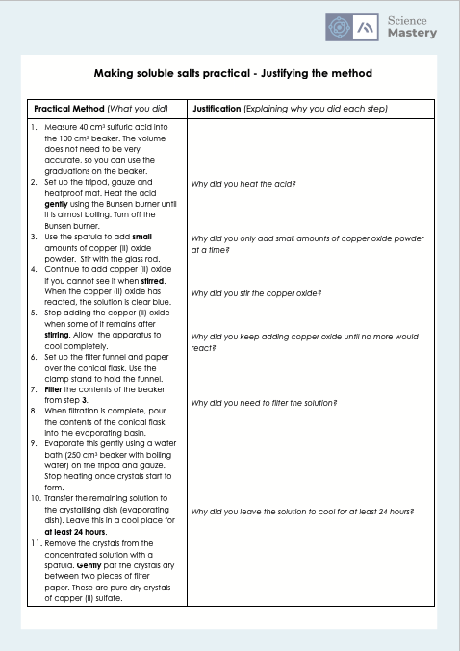
Complete the worksheet

Slide 18
Making soluble salts - calculating concentrations
A student measured 40 cm³ sulfuric acid into the beaker.
Convert 40 cm³ into dm³.
A student reacted a total of 35 g of copper oxide with the acid. What was the concentration of the copper sulfate solution in g/dm³?
Would the solution be more or less concentrated if the student had used 0.05 dm³ of acid? Show your workings.
40/1000 = 0.04 dm³
Concentration = mass / volume
= 35 / 0.04
= 875 g/dm³
Concentration = mass / volume
= 35 / 0.05
= 700 g/dm³
700 g/dm³ is less concentrated than 875 g/dm³
Notes:
Stretch question - A different student made a copper sulphate solution with a concentration of 2.5 g/dm³. The volume of acid reacted was 50 cm³. What was the mass of copper oxide that reacted?
Stretch answer –
Mass = concentration x volume
= 2.5 x (50/1000)
= 2.5 x 0.05
= 50 g

Slide 19
Answer the following questions.
Which piece of equipment would give the most precise measurement of volume?
A. Graduated cylinder
B. Beaker
C. Both A and B
What volume of water is in the graduated cylinder
pictured?
A. 6.6 mL
B. 7.2 mL
C. 7 mL
Why do we need to heat the acid when preparing a solution of copper sulfate?
A. So the water starts to evaporate for crystallisation
B. So the reaction happens faster
C. So that bigger crystals will form
✓
8
✓
6
✓
Notes:
Q1. Answer: A
If students answer B, this suggests a gap in knowledge of the function of graduated cylinders. To fix-it, model for students how a volume of water can be accurately measured using a cylinder and then pour it into a beaker to show that you couldn’t possibly read off the volume in the beaker precisely. Then ask students to compare the accuracy of cylinders and beakers in measuring volumes of liquids.
If students answer C, this suggests a misconception that beakers allow you to measure volume accurately. To fix-it, show students the graduations of a cylinder and of a beaker and explain how you couldn’t possibly measure 6.6 mL using a beaker. Then ask students to describe the functions of beakers and cylinders.
Q2. Answer: A
If students answer B, this suggests that they have incorrectly read the volume from the top of the water line. If students answer C, this suggest that they have incorrectly read the volume from the middle of the meniscus. To fix-it, reteach how to read off volume from the bottom of the meniscus when using a cylinder and then ask students to write a simple method for how to measure 6.6 mL precisely.
Q3. Answer: B
If students answer A, this suggests a misconception that heating the acid is part of the crystallisation process. To fix-it, recap these two steps, explaining how the method links to both purposes. Then ask students to describe (a) how to speed up the neutralisation reaction (b) how to form salt crystals
If students answer C, this suggests the student does not understand the factors that influence the size of the crystals.. To fix-it, reteach how the time taken to crystallise affects the size of crystals and then ask students how you could make the largest salt crystals.

Slide 20
Lesson C3.2.11
What was good about this lesson? | What can we do to improve this lesson?
Send us your feedback by clicking this link
or by emailing sciencemastery@arkonline.org
Thank you!

